Slide 1
MATHEMATICS II
SECONDSEMESTER
06
The Definite Integral

Slide 2
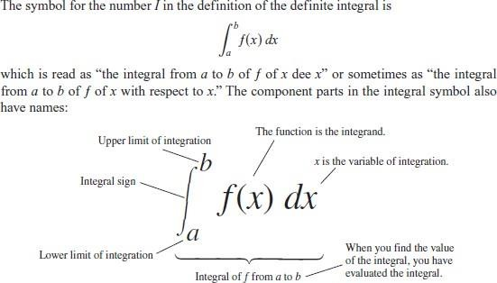
The Definite Integral

Slide 3
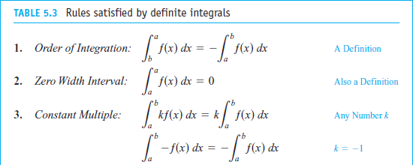
Properties of Definite Integrals
When ƒand g are integrable on the interval [a , b], the definite integral satisfies Rules
1 to 7 in Table 5.3.

Slide 4
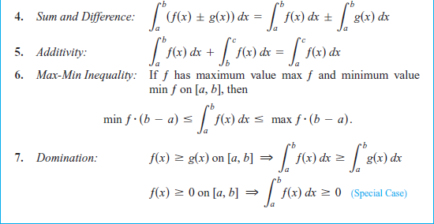

Slide 5
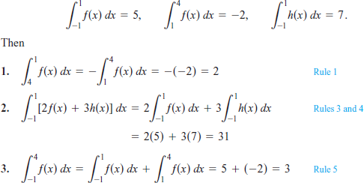
Using the Rules for Definite Integrals, Suppose that.
EXAMPLE 1:

Slide 6



EXAMPLE 2:
Finding Bounds for an Integral
Show that the value of is less than 3\2

Slide 7

Area Under a Curve as a Definite Integral

Slide 8
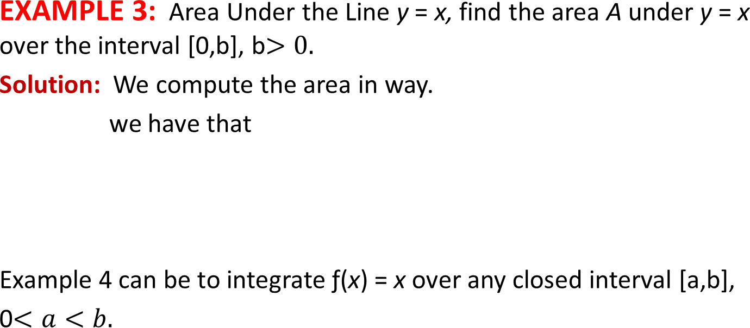
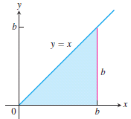

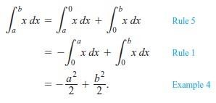

Slide 9
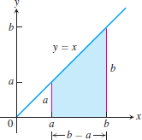

In conclusion, we have the following rule for integrating f (x) = x.
This formula gives the area of a trapezoid down to the line y = x (see Figure).

Slide 10
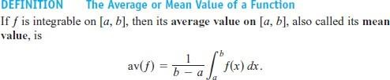
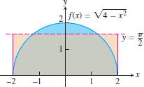


EXAMPLE 4:
on [-2,2].
Solution
:

Slide 11
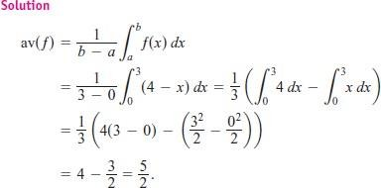
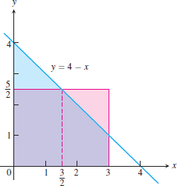
EXAMPEL 5:

Slide 12
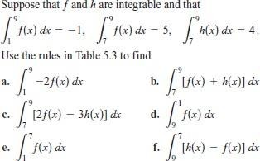
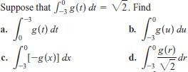
EXERCISES 5.3
1. Using Properties and Known Values to Find Other Integrals.
A.
B.

Slide 13




2. Use the rules in Table 5.3 and Equations (1) to evaluate the integrals in Exercises 41–50.
3. In Exercises 51–54 use a definite integral to find the area of the region between the given curve and the x-axis on the interval [0, b].

Slide 14


4. In Exercises 55–62, graph the function and find its average value over the given interval.
5. Theory and Examples

Slide 15
